Slide 1
Lecture 2: Simulating Buildings and EnergyPlus Auxiliary Programs
Material prepared by GARD Analytics, Inc. and University of Illinois
at Urbana-Champaign under contract to the National Renewable Energy
Laboratory. All material Copyright 2002-2003 U.S.D.O.E. - All rights reserved
Notes:
Notes: __________________________________________________________________
________________________________________________________________________
________________________________________________________________________
________________________________________________________________________
________________________________________________________________________
________________________________________________________________________
________________________________________________________________________
________________________________________________________________________
________________________________________________________________________
________________________________________________________________________
________________________________________________________________________
________________________________________________________________________
________________________________________________________________________
________________________________________________________________________

Slide 2
Importance of this Lecture to the Simulation of Buildings
Simulation of buildings requires 3 main steps:
  Creation of Building Model (Input Definition)
  Utilizing a Simulation Program (Running/Debugging Input)
  Analysis of Simulation Results (Output)
Most of the lectures in this course focus on the first of the three steps since this is where most of your time will be spent
However, using a program and understanding its output is as critical to the proper use of simulation
This lecture focuses on the last two steps since they will be useful throughout the semester and will restrict the discussion to the program we are using this semester: EnergyPlus

Slide 3
Purpose of this Lecture
Gain an understanding of the following EnergyPlus related issues
  Simulation Types
  EnergyPlus Files
  Auxiliary Programs
  EnergyPlus Output
  Handling Errors in Input

Slide 4
Simulation Types
Peak Thermal Load Calculation
  Simulation run for an extreme (design) day or several design days
  Generally used for determining sizing of equipment such as fans, chillers, boilers, etc.
Building Energy Analysis
  Simulation run for an extended period of time: a month, season, year, or several years using weather files
  Includes the building response to the entire range of conditions expected at a particular site
  Helps evaluate the energy cost of the building over longer periods of time

Slide 5
EnergyPlus Files
Let EP-Launch or RunEPlus.bat worry about getting files into the right place
Simple, console app concept
  Energy+.idd – constant
  Energy+.ini – working file paths
  In.idf – input data file
  In.epw – weather data
Input files in working directory
Execution “from” working directory

Slide 6
Files Overview
Simple ASCII files
Simple input format (self-contained)
User-defined output (comma separated data) can be interpreted by many programs
  Spreadsheets
  Databases
  Custom Programs
Note: be advised that the use of some word processing programs to create input files may result in errors due to their use of non-simple carriage returns. Notepad works well if one is trying to create input files “by hand”.

Slide 7
EP-Launch
Assistance in running EnergyPlus
Reads EPL-Run.bat file
Creates RunEP.bat file and executes
Displays run status (eplusout.end)
Can view all input and output files
Several user options available

Slide 8
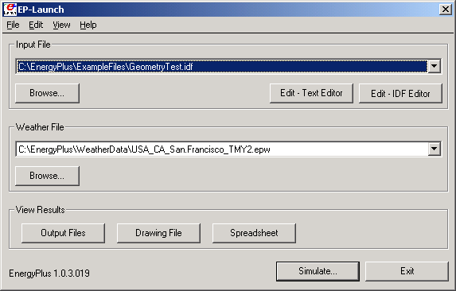
EP-Launch
Access EnergyPlus documentation
Select and edit input file
Select weather file
View output files
Run EnergyPlus

Slide 9
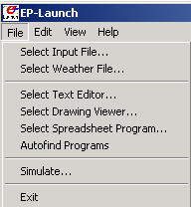
EP-Launch Setup
Select desired text editor program
(defaults to .txt editor)
Select drawing viewer for DXF files (VoloView Express is free from www.autodesk.com)
Select desired spreadsheet program to view csv files

Slide 10
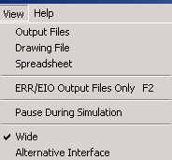
EP-Launch Options
Open only ERR and EIO output files
Pause batch file after EnergyPlus execution to read traceback if crash
Wide format for long path names

Slide 11
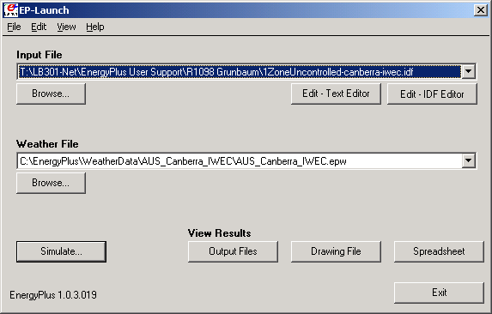
EP-Launch Alternate Layout

Slide 12
IDF Editor
Not really an “interface”
Reads IDD
Structures data entry based on IDD
Writes objects in IDD order
  e.g. Run Period, Design Days, all Materials, all Constructions, all Zones, all Surfaces
  Files generated by other means will be rearranged
CANNOT read IMF files (see EP-Macro)
Some tasks must be done in text editor

Slide 13
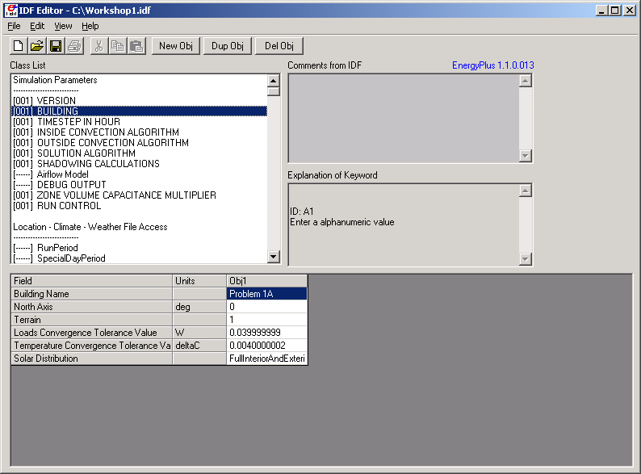
IDF Editor
Select object type from class list
Description of entry, max and min when applicable
Pull-down list of keywords or references when applicable
Objects shown here for selected class

Slide 14
WinEPDraw
Creates dxf drawing
Does not run simulation
*.epderr file reports errors
Run independently
EP-Launch drawing button will run if
  dxf file not present
  dxf file older than idf

Slide 15
Results
ERR file contains warnings and errors (always look here!)
EIO file contains additional EnergyPlus results, including verification of location, environment, summary reports, etc.
View menu – ERR/EIO/BND only (F2)
RDD file lists the output variables available from the run

Slide 16
Results (cont’d)
ESO file contains the raw output from the run (users rarely look here)
CSV versions of ESO and MTR files can be opened by clicking on the “Spreadsheet” button
  Can be imported into any spreadsheet program that accepts the CSV format
DXF file can be viewed by clicking on the “Drawing File” button
  Can be imported into any CAD program that accepts the DXF format

Slide 17
Input Error Detection
Input Processor checks field type, max, min, required fields, based on IDD specifications
Inputs are not processed sequentially
Simulation modules perform additional checks
Certain errors will terminate program before all input has been retrieved by simulation modules
Previously undetected errors may be reported after fixing other errors

Slide 18
Error Diagnostics
ERR file reports any errors that may have occurred during the simulation
  Error messages may be generated during its input phase or during the simulation
  Error messages usually identify specific object type and name related to the error – Use search command to locate error in IDF file

Slide 19
Error Diagnostics (cont’d)
Four levels of error severity:
  Message – Informative. No action required.
  Warning – Take note. Fix as applicable.
  Severe – Should fix. Program may abort.
  Fatal – Program will abort

Slide 20
Error Diagnostics (cont’d)
Running EnergyPlus with CVBbRh.idf results in the following Err file:
Program Version,EnergyPlus, Version 1.1.1
** Warning ** Version in IDF="1.1" not the same as expected="1.1.1"
** Warning ** World Coordinate System selected. Some Zone Origins are non-zero.
** ~~~ ** These will be used in Daylighting:Detailed calculations but not in normal geometry inputs.
************* Testing Individual Branch Integrity
************* All Branches passed integrity testing
************* Testing Individual Supply Air Path Integrity
************* All Supply Air Paths passed integrity testing
************* Testing Individual Return Air Path Integrity
************* All Return Air Paths passed integrity testing
************* No node connection errors were found.
** Warning ** The following lines are "Orphan Objects". These objects are in the idf
** ~~~ ** file but are never obtained by the simulation and therefore are NOT used.
** ~~~ ** See InputOutputReference document for more details.
************* Object=FLUIDNAMES=WATER
************* Object=FLUIDPROPERTYTEMPERATURES=GLYCOLTEMPERATURES
************* Object=FLUIDPROPERTYCONCENTRATION=WATER
************* EnergyPlus Completed Successfully-- 3 Warning; 0 Severe Errors; Elapsed Time=00hr 00min 06sec
Only messages and warnings—EnergyPlus ran successfully

Slide 21
Error Diagnostics (cont’d)
Typo in file
BUILDING,
NONE, !- Building Name
0.0000000E+00, !- North Axis {deg}
Suburbs, !- Terrain
3.9999999E-02, !- Loads Convergence Tolerance Value {W}
0.4000000, !- Temperature Convergence Tolerance Value {deltaC}
FullInteriorAndExterior; !- Solar Distribution
abcdefg
SOLUTION ALGORITHM,
CTF; !- SolutionAlgo
Typo here

Slide 22
Error Diagnostics (cont’d)
Err file error message
Program Version,EnergyPlus 1.1.0.018, 4/23/2003 9:40 AM
************* IDF Line=28 abcdefg
** Severe ** , or ; expected on this line

Slide 23
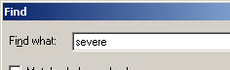
Error Diagnostics (cont’d)
*.audit file for context
Search for error flag
20 BUILDING,
21 NONE, !- Building Name
22 0.0000000E+00, !- North Axis {deg}
23 Suburbs, !- Terrain
24 3.9999999E-02, !- Loads Convergence Tolerance Value {W}
25 0.4000000, !- Temperature Convergence Tolerance Value {deltaC}
26 FullInteriorAndExterior; !- Solar Distribution
27
28 abcdefg
** Severe ** , or ; expected on this line
29
Typo here
Error message here

Slide 24
Error Diagnostics (cont’d)
Crashes
  EP-Launch indicates that EnergyPlus crashed
  EP-Launch→View Menu→Pause During Simulation - adds a pause to view traceback
  Name of failed routine may provide a clue to where the problem lies, e.g., CalcSimple Cooling Coil

Slide 25
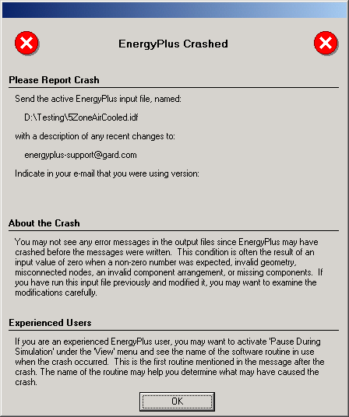
Error Diagnostics (cont’d)

Slide 26
Error Diagnostics (cont’d)
Reports
  Report, Surfaces, DXF
    DXF file that will render the surfaces specified in the IDF file into something viewable
  Report, Surfaces, Details
    Lists all surfaces with area, azimuth, tilt, construction and surface type
  Report Variable Dictionary
    Allows determination of all of the key strings to specify report variables in the input files (produces RDD file)
  Report, Construction
    Lists thermal properties of all construction types

Slide 27
Error Diagnostics (cont’d)
Common Errors
  Missing comma or semicolon
  Inappropriate zero value
  Upside down roof or floor
  HVAC missing components
  HVAC misconnected nodes
  Empty objects in IDF Editor

Slide 28
Summary
Two main simulation categories:
  Thermal load calculations
  Energy analysis
Important input files for EnergyPlus:
  Energy+.idd and Energy+.ini
  In.idf and in.epw
EP-Launch used to select input files and weather as well as executing EnergyPlus

Slide 29
Summary (cont’d)
Output and error diagnostics:
  *.err (and *.audit) messages are not necessarily problems
  Messages and warnings may or may not be important to the simulation (informational in many cases)
  Severe and fatal errors need to be addressed
  Other output files (*.eso, *.csv, *.dxf, *.eio) can also aid in determining problems in user input

